Slide 1
Obj. 4.01 Physical Development 0-12 months

Slide 2
Weight Gain
This is one of the best signs of good health
Most babies lose about 10 percent of their birth weight in the first five days of life
Afterward, they gain weight rapidly
Gain 1 to 2 pounds per month in the first six months
Gain 1 pound per month in the next six months
Average weight of a one-year-old is 20 to 22 pounds

Slide 3
Length
Length instead of height because they are measured lying down
Average baby is 20 inches long at birth
Boys are slightly longer than girls
Average baby at one year is 30 inches long

Slide 4
Body Shape
Hold themselves in a tightly secured position with fists clenched
Skinny arms and legs, large abdomen
Navel cord usually falls off in three weeks
Body straightens out during the first six months

Slide 5
Proportion
Baby’s head and abdomen are large and the legs and arms are short and small
Skull has fontanels (soft spot)

Slide 6
Vision
Vision is blurry at birth but within a week or so, infant is aware of surrounding.
Improves rapidly during the 1st year.

Slide 7
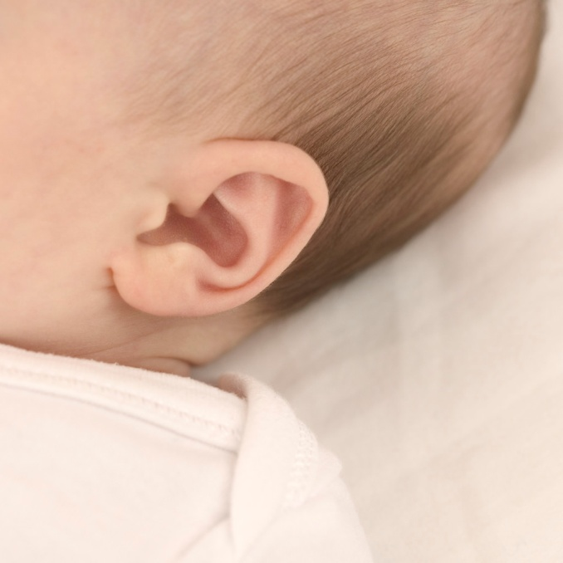
Hearing
Language develops with hearing spoken words.
Can tell the direction of sound.

Slide 8
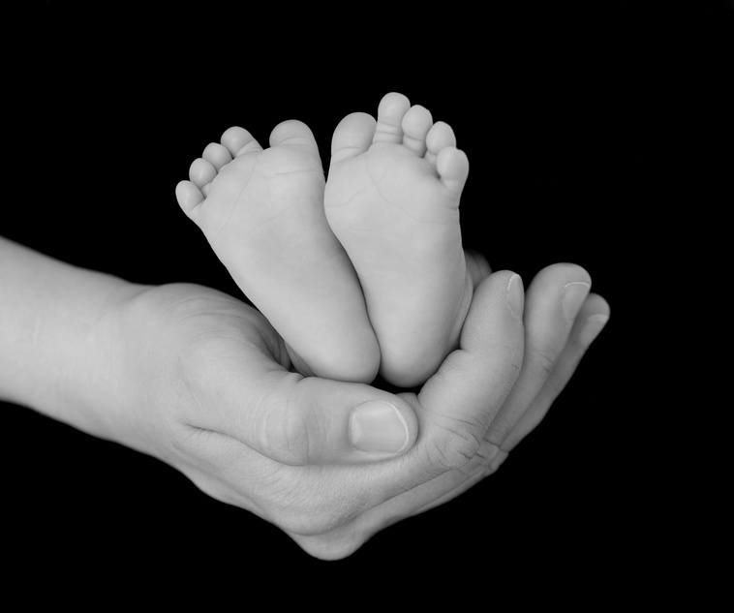
Touch
Teaches infant about the environment
Becomes a more important sense for learning as the years progress.

Slide 9
Smell and Taste
In ten days they can distinguish their mother from other people by smell.
Two week old babies can taste the difference between water, sour, sugar, salt and milk.

Slide 10
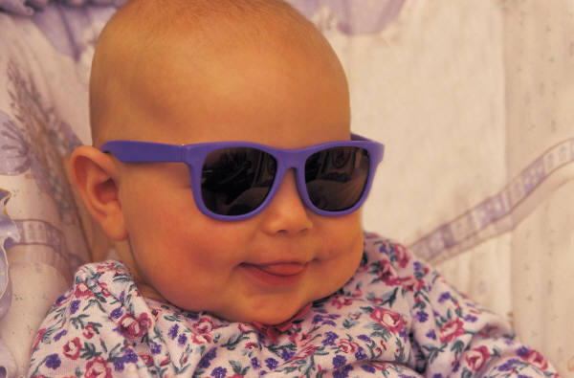
Voice
Shrill but softens as lungs mature
Changes in voice results from physical growth of the throat muscles, tongue, lips, teeth.

Slide 11
Motor Skills
At birth babies have little control over their muscles
Gross motor skills involve use of large muscles such as arms and legs
Fine motor skills involve use of small muscles such as hands and fingers
Touch becomes a more important sense for learning as year progresses
Milestones of gross and fine motor skills occur

Slide 12
Reflexes
At birth babies have an automatic set of reflexes to help them survive
Startle
Grasp
Sucking
Rooting
Babinski

Slide 13
Grasp
Grasp: makes a fist over object placed in hand

Slide 14
Sucking
Sucking occurs when something is put in a baby’s mouth

Slide 15
Rooting
Rooting: when cheek is stroked, baby turns toward the side stroked with open mouth

Slide 16
Babinski
Babinski reflex occurs when baby’s foot is stroked and the toes fan out and foot twists in

Slide 17
Startle
When baby’s position changes quickly or a loud noise occurs baby throws head back, arms out and arches back

