Slide 1
2.03 Careers In Education
Entry- Level
Associate’s Degree
4- Year Degree
Graduate Degree and Above

Slide 2

Entry- Level
NOTE:
To change images on this slide, select a picture and delete it. Then click the Insert Picture icon
in the placeholder to insert your own image.
Babysitter: Take care of the child while the parents are temporarily away.
Childcare teacher assistance: Assist classroom teacher in daily classroom activities.

Slide 3
Entry Level
Camp Counselor
Puppeteer
Responsible for planning, leading, and implementing core and non-core programs and experiences for children in a small group setting.
Originates puppet shows, designs and constructs puppets and moves controls of puppets to animate them for entertainment of audience

Slide 4
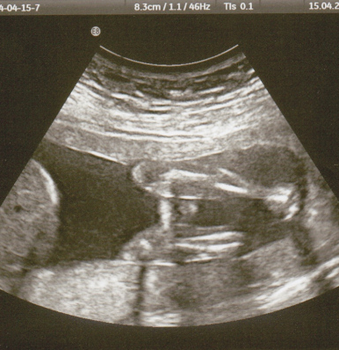
NOTE:
To change images on this slide, select a picture and delete it. Then click the Insert Picture icon
in the placeholder to insert your own image.
Sonographer: Use technology to create and interpret images from inside the human body. Often used for Ultrasounds.
Associate’s Degree

Slide 5
~Giving medication as prescribed by a physician.
~Taking vital signs, such as blood pressure, temperature, and weight
~Basic wound care including cleaning and bandaging injured areas
~Giving injections of medication
~Immunizations
~Taking medical histories, entering information into computer systems
Dental hygienist
Clean teeth, examine patients for signs of oral diseases. Provide other preventive dental care. Educate patients on ways to improve and maintain good oral health.
Nurse – LPN
Associate’s Degree

Slide 6


4 Year Degree
NOTE:
To change images on this slide, select a picture and delete it. Then click the Insert Picture icon
in the placeholder to insert your own image.
Activities director: Develop programs and coordinate recreational activities for participants.
Special education teacher: Work with children and young adults who need extra support to complete their learning successfully.

Slide 7

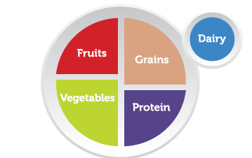
4 Year Degree
Dietitian: Plan food and nutrition programs and supervise the preparation and serving of meals. Help prevent and treat illnesses by promoting healthy eating habits and recommending dietary modifications.

Slide 8


NOTE:
To change images on this slide, select a picture and delete it. Then click the Insert Picture icon
in the placeholder to insert your own image.
Child psychologist and psychiatrist(medication): Help children deal with behavior, emotions and feelings problems.
Graduate Degree and Above
Pediatricians: Physician who specializes in development, care, and diseases of babies and children.

Slide 9
Graduate Degree and Above
OB/GYN: Specialists whose focus is women's health.
Physical Therapist: Help injured or ill people improve their movement and manage their pain.

